Slide 1
YUGMA App GTM STRATEGY : ROUND 2
Team Sorted
Mohit Kiradoo
Kajal Gupta
T. A. Pai Management Institute (TAPMI)
PGDM: 2021-23

Slide 2






Understanding of the case
Relevance
Attractiveness
Commercial Feasibility
Current needs of management students which makes the idea relevant for them
Growing number of management students in India currently 5.97 Lakhs¹
Fragmented Market since the industry is not yet defined and maximum players are trying to achieve product market fit
Unexplored market of tier 2 and tier 3 B-Schools as well as BBA/BMS institutes in terms of services offerings, penetration
Community Driven platforms are the new trend where students come together and have a peer-to-peer learning at an inter-b-school level
Major Revenue Streams
Placement preparation workshops
Hiring challenges commissions
Advertisement and promotions
Mentorship bootcamp fee and commissions
YouTube ad revenue
Premium membership fee
Additional practical learning
Gamified engagements
Business challenges
PPO/PPI opportunities
Live Project opportunities
Industry expert advices
Placement preparations
Potential Challenges
Current needs of corporates and professionals which makes the idea relevant for them too
The major challenges faced by the benchmarked companies in terms of monetization are:
Only 2% of the userbase subscribe for the pro membership
It takes a lot of time and loyalty building to introduce paid services
Pool of talent at one place
Platform for hiring challenges
Student community
B-School reach & engagements

Slide 3









Essential components of an app for MBA students
Process
Primary research
Sample size: 198 (71% M, 29% F)
Tier 1 B-Schools: 3
Tier 2 B-Schools: 8
Tier 3 B-Schools: 4
Other Attributes: 42%
Freshers & 65% 1st Years.
Benchmark
(market leader)
Identification of factors:
Hygiene factors: UI, UX, App size, App speed
Delighting factors: App Color, Image resolution
Offerings: Frequently used services, most important offerings, Missing offerings
Questionnaire
Why app?
Time spent?
Features?
Benefits? Etc.
Rankings:
Results
UI/UX
App Size
Security
App Speed
App Colour
Questionnaire

Slide 4




Compelling factors to download the app
User persona and their unmet needs (As per the primary research, community discussions and personal experience)
Case Enthusiast
Networking geek
Information Digger
Opportunity Seeker
Mohit is from a tier 2 college and has a knack of solving cases but is:
Having very less case competition opportunities
Unaware of the upcoming case competitions
Unaware of what approach to take for case studies
No proper guidance or mentorship on case studies and clearance of quizzes
Devesh is from a tier 2 college who wants to expand its network thus is :
Looking for a platform for interacting with students from other colleges
Looking for a community/forum to discuss on various topics such as Product management, analytics etc.
Looking for a platform where he can read articles, news about the stock markets and exchange views
Kajal from a tier 3 college is an avid information seeker & thus is looking for a platform for:
Informative sessions could be provided by CEOs/CXOs etc. about the latest market trend
Placement/Internship prep sessions on Interviews, guesstimates, group discussions etc.
Counselling session on which domain to get into.
Yash is constantly looking for opportunities to enhance his knowledge gather experience
Placements, internships, live projects, various competitions, research etc.
Certifications on multiple topics such as consultation etc. and a hands-on experience along with that.

Slide 5




Compelling factors to download the app
To cater to the unmet needs of the students, YUGMA can segregate its app into 4 sections
Competition training
Forum
Mentorship Programs
Live Projects
Conduct Sessions or Webinars by the previous winners of multiple competitions for the students for proper guidance
Share the PPTs of the previous case winners on the platform for better approach towards the cases
Forum feature in the app
From the dropdowns of Forum list, students can choose the forum in which they want to have a discussion
Provide push notifications to the registered students about the latest happenings in the business domain and the tech industry
Mentorship sessions by top leaders on the latest trends in the industry
Mentorships sessions by the experts on Placement/Internship prep
Counselling sessions wherein students can get clarity about which domain to get into(marketing/finance etc.)
Conduct certification courses followed by relevant Live Projects for hands-on experience
Case challenges for solving real life business problems in different domains such as (Product management, Supply chain simulations or Financial modelling challenges
Strategic communication to increase app downloads
Campus ambassador programs
Referral Program
Exclusive content
Redeemable rewards or app coins with B2B collab⁴
Promotes app downloads in their campus and outside
Refer a friend and earn rewards/coins/cash
Most in-demand content only on app
B2B collaborations with new start-ups for their sales promotions ( Ex – Appendix)

Slide 6

Competition Analysis
Industry specific mentorship programs (Ex – PM, FMCG, Consulting)
Freemium model (Ex – Limited free content and exclusive paid content)
Community based mentorship programs (Ex – Peer to peer learning)
Case competitions mentorship (Ex – How to ACE xyz competitions)
Player | Strengths | Weaknesses
Unstop | Huge popularity, UI/UX, Corporate connections, Gamified challenges | 90% traffic is only for case competitions, no community,
Inside IIM | Huge popularity among aspirants, YouTube videos, Konversations Café, B-School reviews | Traffic is low as students mostly prefer it during pre-MBA and post CAT/XAT phase (hardly 4 months)
Btribe | Huge Brand loyalty for parent company, High monetization (Avg. Workshop cost Rs 3000) | Less awareness, Only career counselling and how to ace competitions workshops
Sociocharge | Unique idea of a community-first platform | Less awareness, Very small user base, UI/UX
Grad Partners | Workshop & Events, Community, AceTheCase | Fewer competitions hosted, Lesser college penetration
Navkiran | Placement Bootcamps, Student community | No competitions hosting, No corporate connect
MBA Exchange (Global) | International Exposure, International Case Competitions | Less awareness, No collaboration with Indian companies
Key trends in mentoring management students
We have identified 2 companies as benchmark for YUGMA based on certain assumptions:
If Case Competitions are the primary focus to drive traffic
If Workshops and Mentorship Programs are the primary focus
The key strengths of YUGMA to disrupt the market should be excellent UI/UX, deep institute penetration, lively community & engagements

Slide 7









Business Model
Current State
Business Goal(s): YUGMA aspire to enhance collaboration between Organizations and B-Schools, across geographies.
Offerings: (yugma.ai)
As-Is analysis of the current offerings, website structure, app features etc.
For students
Element | Current state | Importance | Outcome | Benchmark
Competitions | 10-12 till date | Preferred by 98% of the users | Less awareness | Unstop
Upskilling | Masterclass are not getting played¹ | Preferred by 44% of the users | User dissatisfaction | Navkiran
Assessments | Only 1² | Preferred by 25% of the users | User dissatisfaction | Unstop Pro (Paid version)
Placements | Very few | Preferred by 85% of the users | Bad Brand image & corporate connect | Unstop Pro
Website SEO | Poor. There are two websites, and the static website appears on google search³ | Is a major attribute for organic search ranking with relevant keywords | Less organic reach, less awareness | Unstop (Ranks top with majority keywords)
App UI/UX | Poor | Rank 1 attribute | Dissatisfaction, early uninstalls | Unstop
competitions
Upskilling
Mentorship
Assessments
Placements
Articles
For institutions/mentors
Live masterclass
Host competitions
Host jobs/projects
Appendix
To suggest any new business model, we must ensure the internal factors such as Supply side, UI/UX, Website and Business goals to be sorted

Slide 8
Business Model (Continued)
Proposed Model
What’s New?: 1) Offerings that serve the unmet need, 2) Clear Value Proposition, 3) Community, 4) Corporate connect
The Golden Circle of the proposed business model
We propose a FREE-MIUM monetization plan for the given model
A Certification and mentorship platform that provides industry ready certification from the CXO level executives of different industries followed by a Live Project to practically apply the learnings and add value to the achieved certification in resume.
Free basic certifications, masterclasses to onboard new users on the platform
Paid (Nominal cost) CXO level certifications bundled with relevant Live Projects
What?
By providing most sought-after certifications by management students (Ex – Digital marketing, Financial modelling, HR analytics, Consulting 101 etc and collaborating with the clients of Vmentor.ai to float Live Projects relevant to the certification (Ex – Digital marketing strategy for ABC limited (1 month LP), Financial Modelling of XYZ Ltd (2-month LP)
Customers
Students
Institutional
Corporates
Placement Guidance**
Student discussion forum**
Business news vertical***
Certification packages**
Career development outsourcing**
Corporate connect*
Best in the industry talent***
Short term projects help***
How?
Other offerings and their need
Majority of the certification platforms such as Coursera, Udemy etc does not provide India specific content plus the certification is of no use if there’s no practical application and it’s the biggest unmet need of the management students as of now
Why?
* High need
** Moderate need
*** Low need

Slide 9





Go to Market Plan
Journey of an MBA student
Entrance Exams
Admissions
Summer Internships
Placement
Journey mapping by YUGMA
Journey
Case competitions, certifications, Live Projects Etc.
Placement preparation, Resume building, mentorship
Helping in the journey of college selection with relevant articles, information, basic pre-MBA certifications
Case competition masterclass, General management certifications, Live Projects, Internship readiness program, resume building sessions, business news articles & videos, domain specific knowledge sharing, community building programs, campus ambassador programs
SIP presentation masterclass, Post SIP resume building, Pre-placement certifications, Career guidance workshops, Field specific roles guidance (Ex – Product manager in Fintech, ASM in FMCG), pre-placement resume building, pre-placement live projects, Placement mock interviews, placement mock tests and quizzes
Catching the early birds with informative videos and tips etc
Product revamp with new offerings and USP
Alpha testing within the organization
Beta testing with a selected group
Implementation of feedback received
Market launch of new app and website
Promotions, Events & PR
New product journey
01
02
03
04
05
06

Slide 10













Go to Market Plan (Continued)
Phase 1
Phase 2
Phase 3
Objective
New User Acquisitions
User engagement, delights
User retention
Communication
B2B Collab
Pitch Deck, Product Fit
Cold Emails, Events, Free Demo
Consistent Quality, Feedback
Hurdles
Product Market Fit
Supply-Demand Gap
Change in industry trends
Solution
User feedback & improvements
Supply pipeline, BCP and forecast
Pro-active approach
MRR (Monthly Run Rate) = Avg. Revenue Per User X Number of Users
Stickiness Ratio = DAU/MAU (DAU = Daily Active User. MAU = Monthly Active User
CAC = Total spend on marketing and sales / Number of new users acquired
LTV = Average user sale value X Average user lifespan
User Churn Rate = (User lots in a period / Total users at the start of the period) X 100
Requirements:
Product Manager
Marketing Manager
Business Development Executive
Important KPIs

Slide 11


Why You?
Implementation
Our Contribution
Contact and collaborate with multiple
Tier 2 and Tier 3 colleges
Select campus ambassadors from those colleges
Provide them directions about the promotion of the app amongst the students
Keep them updated regarding the latest offerings and events getting hosted on YUGMA
Spread awareness about YUGMA app and its offerings in our colleges
Connect with top brands and companies to provide live project /Internship opportunities for students
Connect with top leaders from various domains to provide sessions to students on latest trends in the market
Connect with professionals to provide students with mentorship and placemen t prep sessions
We’ll follow the STAR approach
Situation : With the help of this case we have gotten an idea about the situation at YUGMA in terms of the issues which it is facing
Task : We are fast learners and can work efficiently to make thinks work for YUGMA. To cater to those issues, we ha come up with multiple strategies to increase an overall userbase of YUGMA app.
Action : With our unique vision and our innovative and creative approach, we can implement these strategies successfully. Also as YUGMA operates in a very competitive market, we believe our skills and knowledge will help in finding ways to beat the competition.
Result : This overall approach will in turn help in increasing the userbase of YUGMA, along with this It’ll help in increasing the profits and revenue of YUGMA
2 Months
2 Months
2 Months | 4 Months | 6 Months
P
L
A
N
Tier2 and Tier3 college tie ups
Selecting Campus ambassadors
Spreading awareness amongst the students
Connecting with top brands for Internships/LP
Connecting with Professionals for sessions

Slide 12
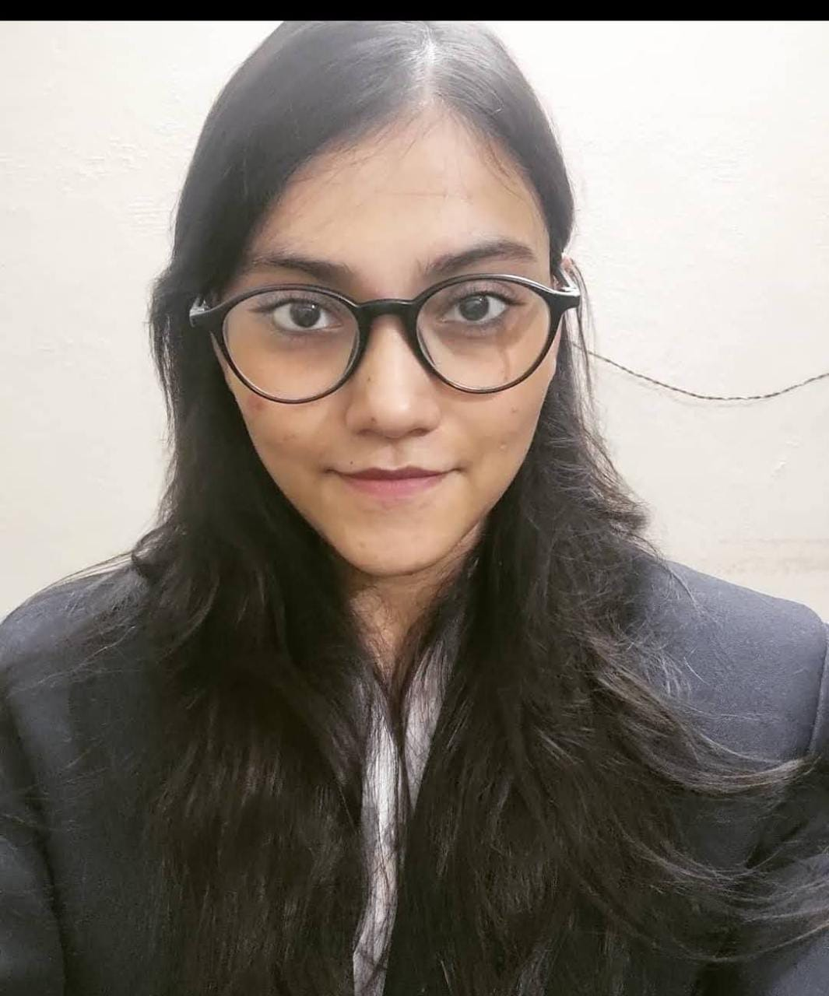
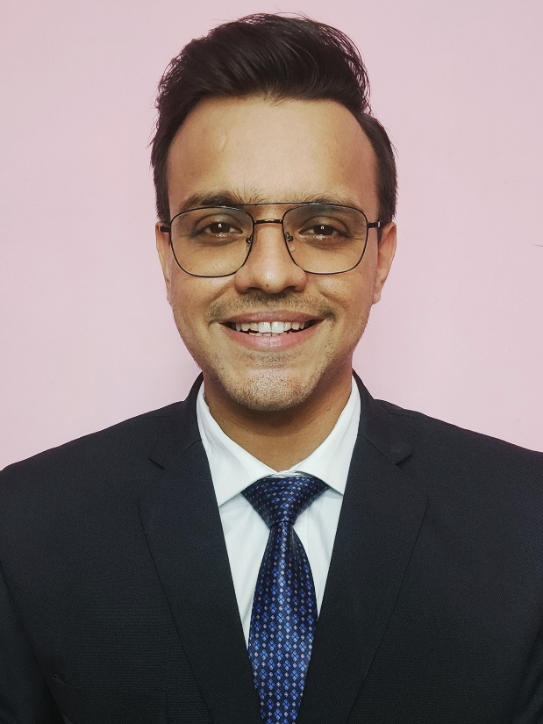
Fun @ Work
We would request you to attach a Photograph of your team at your working place
(Working place - Work from home or college)
TEAM SORTED

